Slide 1
BIOMASS DYNAMIC MODELS
Joseph T. DeAlteris
University of Rhode Island
Kingston, RI

Slide 2
Presentation Outline
Purpose
Background
Graham-Schaefer Model
Projection Model Application
Retrospective Model Application
Summary and Conclusions

Slide 3
Background on Schaefer Model (1954-1957)
Assumed that for each level of fishing effort there was an equilibrium sustainable catch that was equivalent to the surplus production at the particular stock biomass level.
Assumed that if the level of fishing effort changed then stock biomass changed immediately, and produced a surplus production that was removed as catch.

Slide 4
Background on Schaefer Model (1954-1957)
(cont.)
Relation between surplus production (catch) and stock biomass is a dome-shaped function, based on the logistic model of population growth.

Slide 5
Surplus Production Model
MSY
Yield
B
MSY
0
0
2
4
6
8
10B
12
Biomass

Slide 6
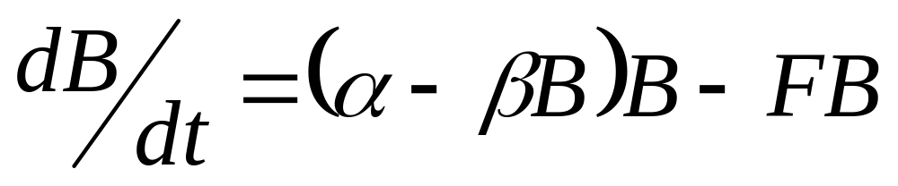
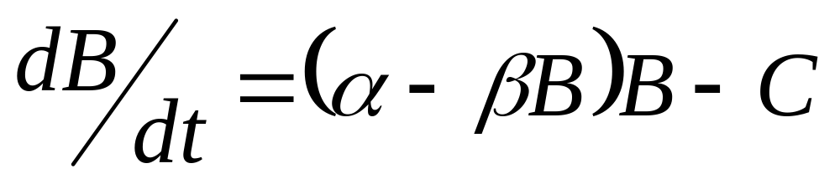
Schaefer Model

Slide 7
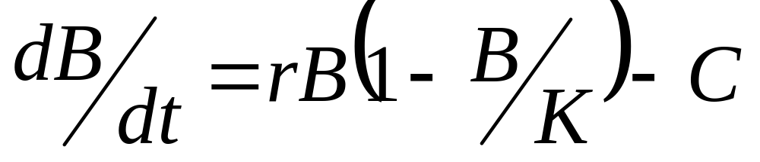
Graham-Schaefer Model:
Differential Equation Form
where,
B is stock biomass,
C is catch rate,
r is the intrinsic rate of stock growth, and
K is the unfished stock size at carrying capacity

Slide 8
Similarity between Graham-Schaefer and Schaefer Models:
r = α and,
r/K = β

Slide 9
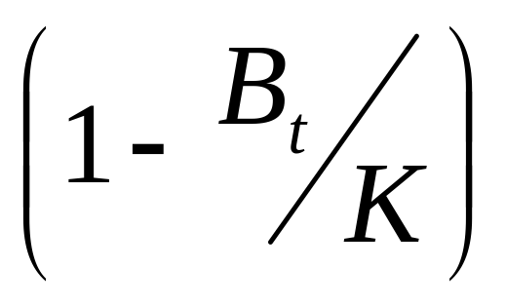
B_{t}
Density Dependent Feedback Term (DDFT)
As → K, DDFT → 0
As → 0, DDFT → 1
B_{t}

Slide 10
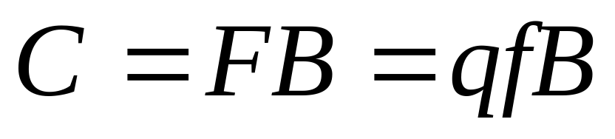
Relationship Between Catch
and Stock Size
where
C is catch rate,
F is fishing mortality,
q is catchability coefficient, and
f is fishing effort.

Slide 11
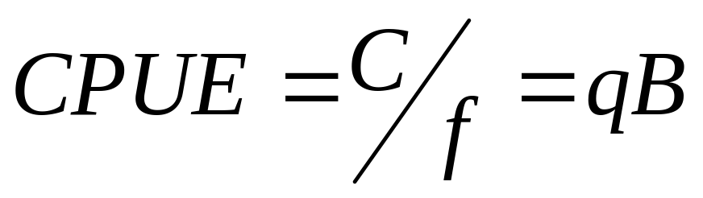
Catch Per Unit Effort (CPUE)

Slide 12
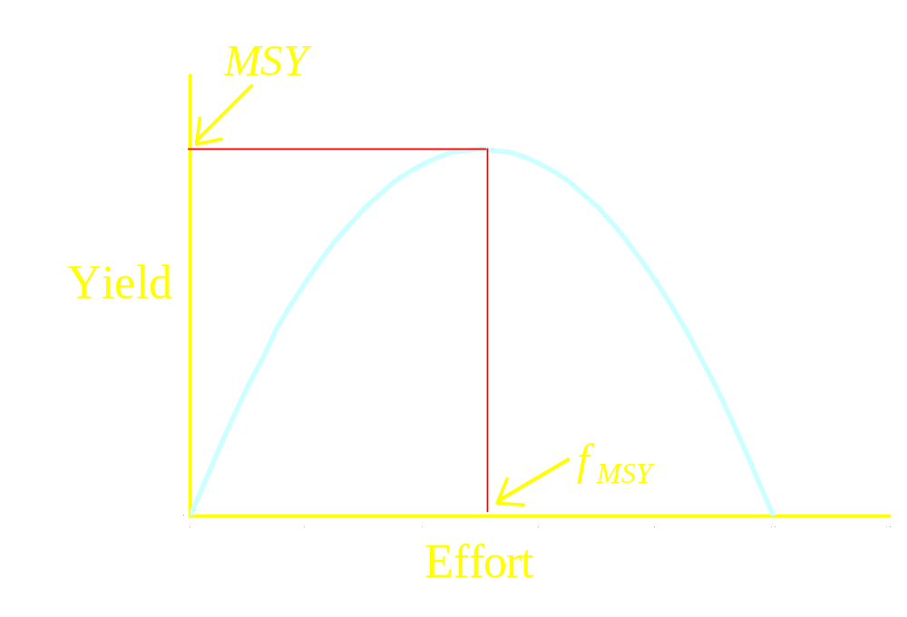
Schaefer (1954) Model

Slide 13
Background on Schaefer Model (1954-1957)
(cont.)
Equilibrium assumption is always violated, therefore equilibrium models usually result in over-optimistic estimates of biomass.
Improved methodology is the use of the surplus production model as a discrete time equation applied to a time-series of data.

Slide 14
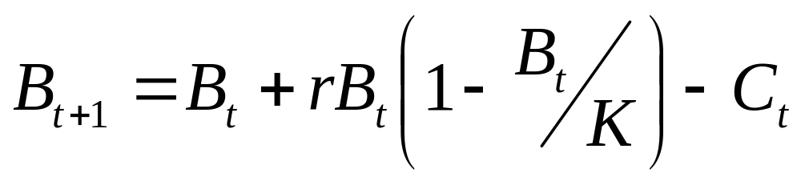
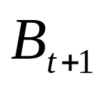
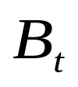
Graham-Schaefer Model:
Discrete Time Equation Form
where
is the stock biomass in the year following the “t” year,
is the stock biomass in the “t” year,
K is the unfished stock biomass at carrying capacity, and
r is the intrinsic rate of stock growth.

Slide 15
Relationship Between Catch and Stock Growth
If Catch > Surplus Production → Stock Decline
If Catch < Surplus Production → Stock Expansion

Slide 16
Projection Model Application
Use the discrete form of the dynamic biomass equation to investigate the sensitivity of the model output, , to variations in catch, and the input parameters , K, and r.
Evaluate the effect of the intrinsic rate (r) on stock biomass and growth rate assuming a starting biomass ( ) of 1 mt and a carrying capacity (K) of 100 mt, and zero catch. Note that limits on r for most marine fishery resources are: 0.1 < r < 1, therefore evaluate r values of 0.2, 0.4, 0.6, and 0.8.
Evaluate the effect of catch on the stock biomass using a variety of catch histories with of 25, 50, and 100 mt,
r of 0.5, and K of 100 mt.
B_{t}
B₀
B₀
B₀

Slide 17
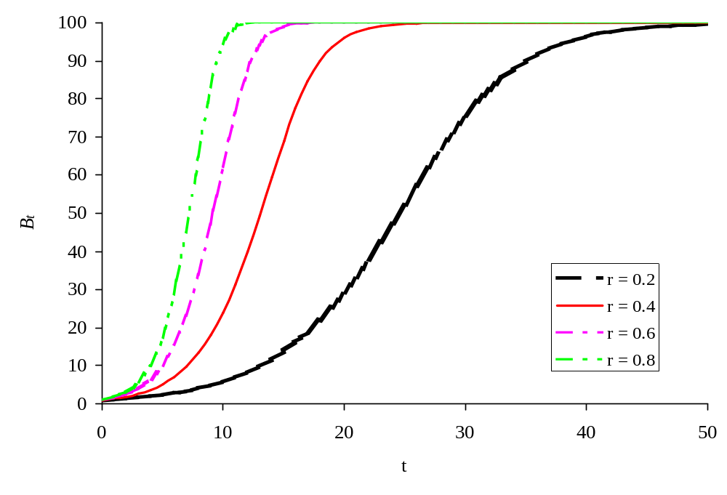
Effect of the Intrinsic Rate of Growth (r) on the Stock Biomass Trajectory ( )
B_{o}

Slide 18
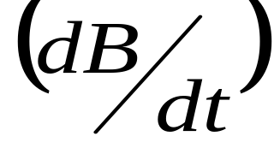
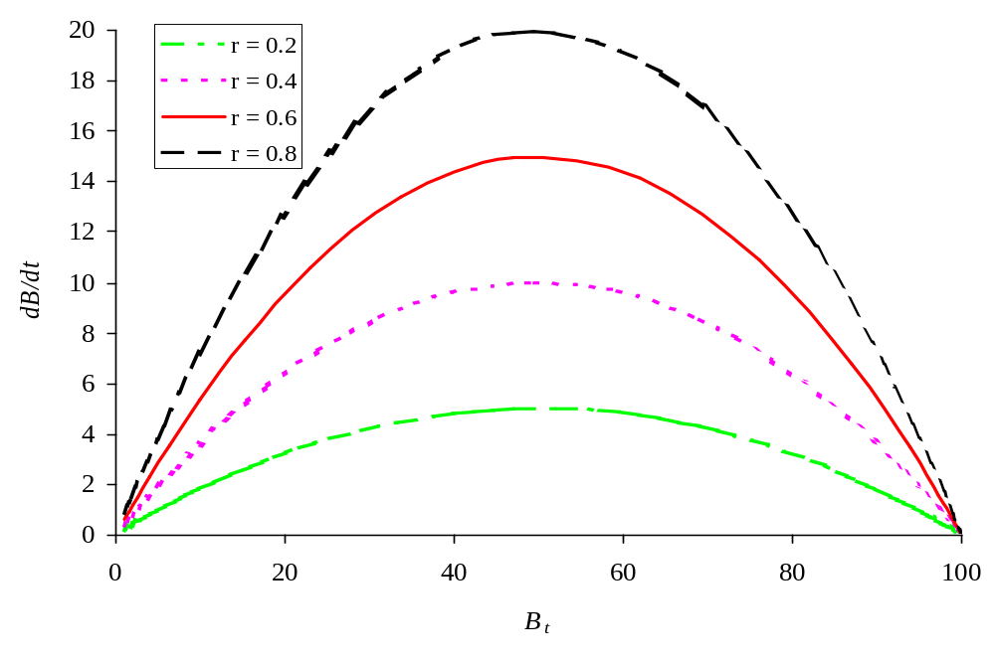
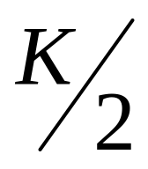

Effect of the Intrinsic Rate of Growth (r) on the Stock Biomass Growth Rate as a Function of Biomass (B).

Slide 19
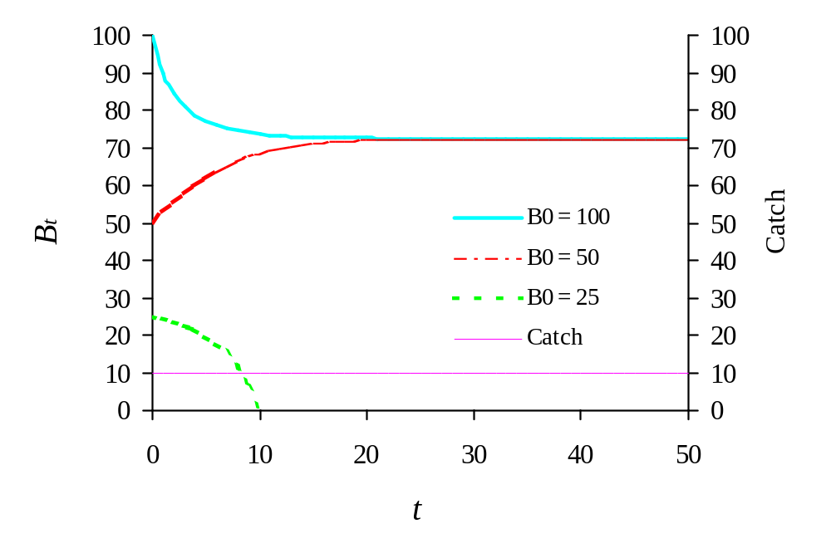
Effect of a Constant Catch of 10 mt on the Stock Biomass Trajectory

Slide 20
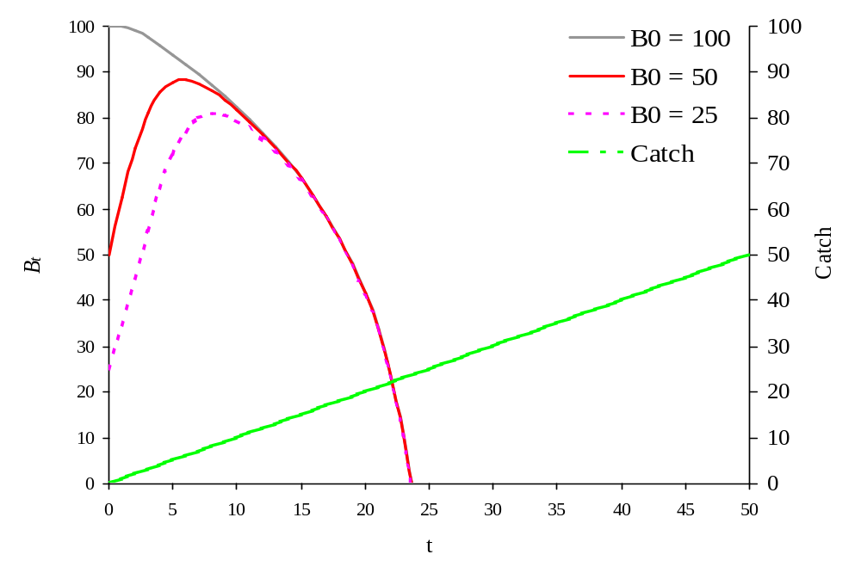
Effect of Increasing Catch from 0 to 50 mt on the Stock Biomass Trajectory

Slide 21
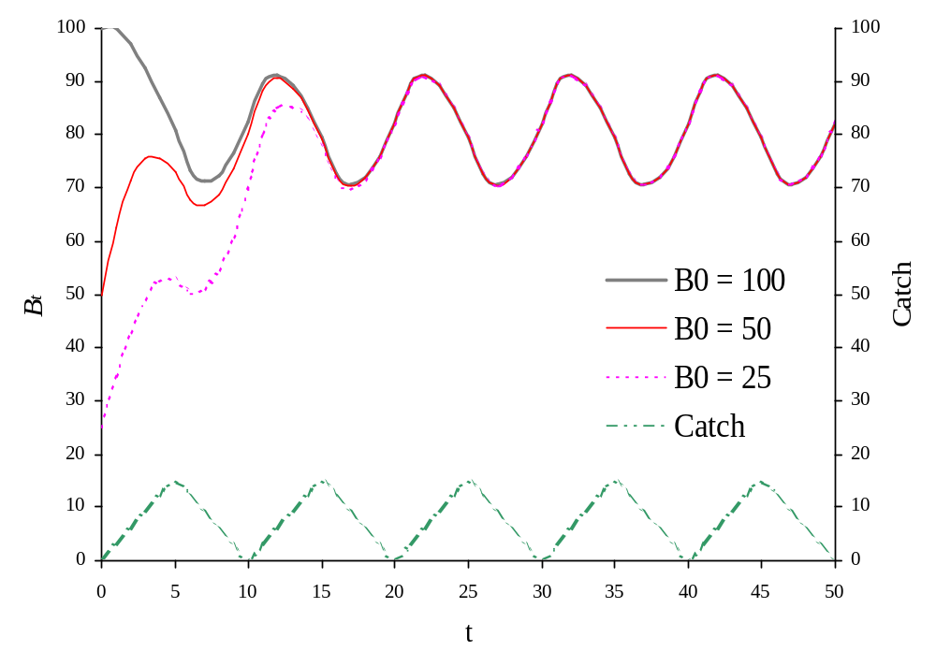
Effect of an Oscillating Catch with a Period of 10 Years and Maximum of 15 mt on the Stock Biomass Trajectory

Slide 22
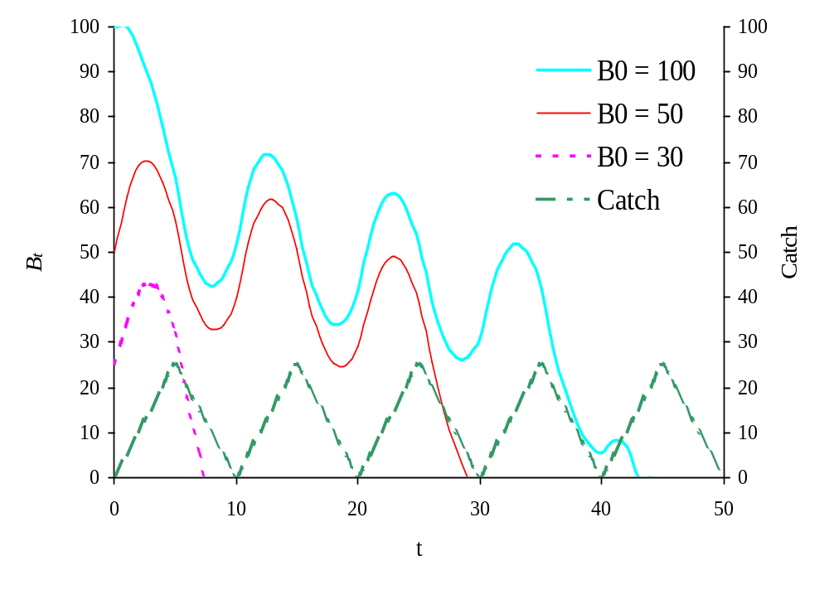
Effect of an Oscillating Catch with a period of 10 Years and a Maximum of 25 mt on the Stock Biomass Trajectory

Slide 23
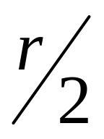
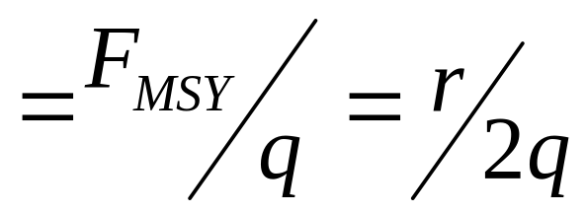
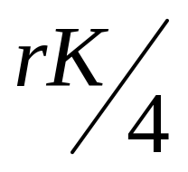
Other Management Parameters that Result from the Surplus Production Models:
Fishing Rate at MSY: (F_{MSY}) =
Effort at F_{MSY:} (f_{MSY})
Maximum Sustainable Yield (MSY) =
Stock Biomass at MSY: (B_{MSY}) =

Slide 24
Retrospective Model Application
Given data on catch history and a relative index of abundance (survey or fishery data, estimate biomass historically and fishery management parameters: MSY, F_{MSY}, and B_{MSY} .
Using initial estimates of K, r and B_{o}, calculate an estimated biomass time series and a relative index of abundance. Estimate a mean catchability coefficient (q).
Using SOLVER, adjust K, r, and B_{o} so as to match the actual and estimated indices of abundance, using Maximum Likelihood or Least Squares methods.
Use final estimates of K and r to estimate MSY, F_{MSY}, and B_{MSY} .

Slide 25
Fitting Data to
Biomass Dynamic Models
Process Errors- due to the assumed form of the model
Observation Errors- due to errors in measurement
Number of Parameters to be estimated is the number of dimensions plus 1 for the search, greater chance of multiple local minimums, more difficult to identify the global minimum.

Slide 26
Methods of Fitting Data to a Biomass Dynamic Model
Assuming Observation Error
Least Squares Estimation- minimize the sum of the squared residuals between the observed and estimated indices of abundance by adjusting the values of r, K & Bo.
Maximum Likelihood- maximize the probability that the observed data have occurred given the assumed model and the set of parameters estimated by adjusting the values of r, K, and Bo

Slide 27
Selection of Starting Values for the Estimated Model Parameters
r - the intrinsic growth rate
  0.1 or less - for very long lived and slow growing animals, marine mammals or sturgeon.
  0.2- for long lived, slow growing fish, M=K=0.2
  O.4- for fish with M=K=0.4
  O.6- for fish with M=K=0.6
  O.8- for fish with M=K=0.8

Slide 28
Selection of Starting Values for the Estimated Model Parameters
K – carrying capacity
  20 x Y_{msy}, if r = 0.2
  10 x Y_{msy}, if r = 0.4
  7.5 x Y_{msy}, if r = 0.6
  5 x Y_{msy}, if r = 0.8

Slide 29
Selection of Starting Values for the Estimated Model Parameters
Bo – initial biomass
  Bo = K, if initial catches are very low and Index is high, suggesting virgin stock
  Bo = 0.5*K, if initial catches moderate and index is stable, suggesting harvest at B_{msy}
  Bo = 0.25*K, if initial catches high, and index is in decline, suggesting an overfished stock

Slide 30
Selection of Starting Values for the Model Parameters
Bo – initial biomass fixed, not estimated
  Bo = K, if initial catches are very low and Index is high, suggesting virgin stock
  Bo = 0.5*K, if initial catches moderate and index is stable, suggesting harvest at B_{msy}
  Bo = 0.25*K, if initial catches high, and index is in decline, suggesting an overfished stock

Slide 31
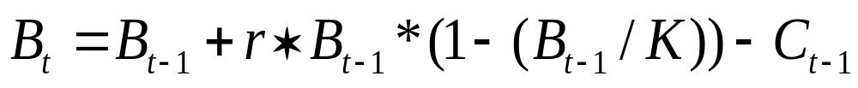
Least Squares Solution
Estimate a biomass trajectory Bt, start with Bo, use starting r and K values.
Use the Max function (equation, value) to prevent the cell from going negative in the Solver search

Slide 32
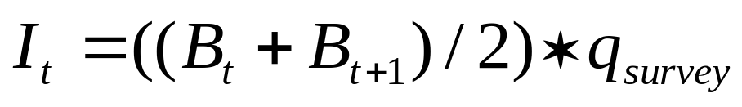
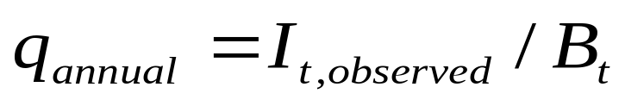
Least Squares Solution
Estimate the Index of Abundance (I_{t})
Estimate the q_{survey} the average of the annual qs, and the annual q is estimated as

Slide 33
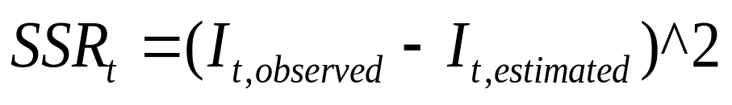
Least Squares Solution
Use Solver to minimize the sum of the annual residuals squared (SSR) between the observed and estimated Indices of Abundance, and the annual SSR is estimated as

Slide 34
Maximum Likelihood Solution
Estimate a biomass trajectory Bt, start with Bo, use starting r and K values.
Use the Max function (equation, value) to prevent the cell from going negative in the Solver search

Slide 35
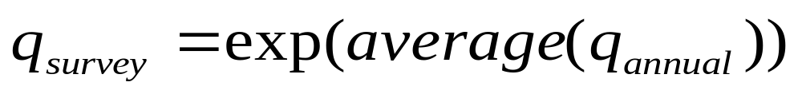
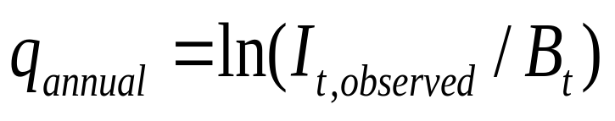
Maximum Likelihood Solution
Estimate the Index of Abundance (I_{t})
Estimate the q_{survey} the exponent of the average of the annual qs, and the annual q is estimated as

Slide 36
Maximum Likelihood Solution
Use Solver to maximize the log likelihood (LL)
Sigma is the square root of the sum of the Ln of annual residuals squared (SSR) between the observed and estimated Indices of Abundance divided by the number of observations (n).

Slide 37
Retrospective Model Example
Consider the following 50 year time series of catch data and a survey index of relative abundance.
Calculate an estimated survey Index, r, K, and B₀, and the relevant fishery management parameters (MSY and B_{MSY})

Slide 38
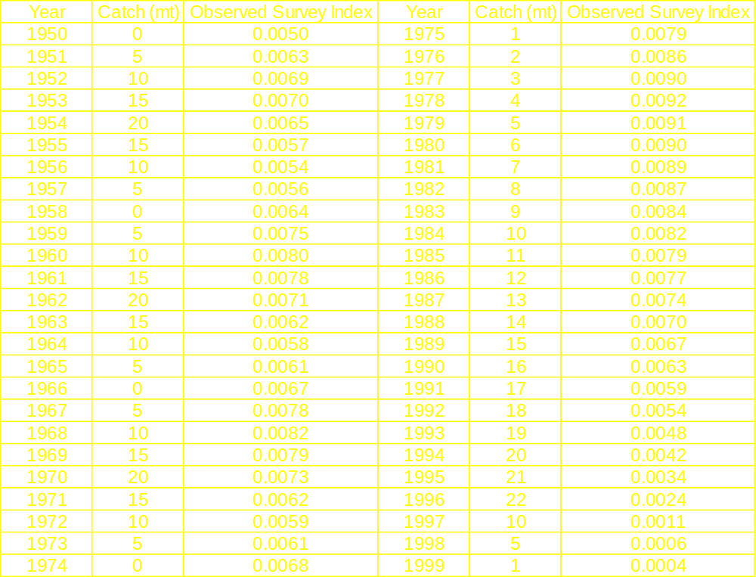
0
0
2
4
6
8
10
12

Slide 39
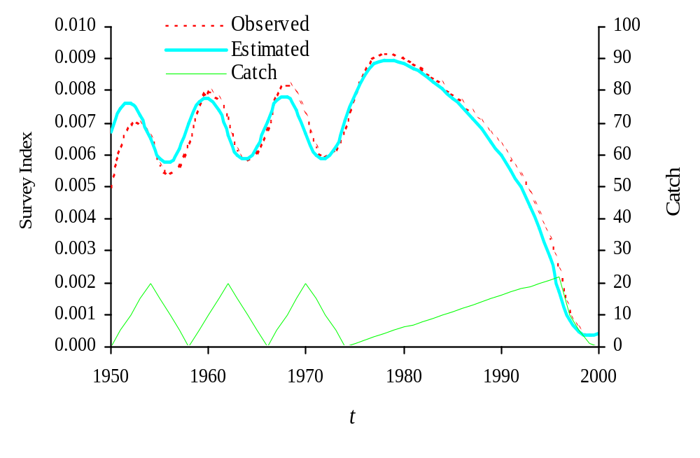
Time-Series Plot of Catch and Observed and Estimated Indices of Relative Abundance

Slide 40
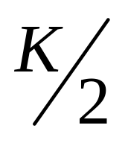
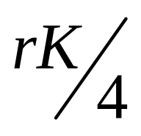
Estimated Fishery Parameters:
r = 0.444
K = 107.94 mt
B_{MSY} = = 54.4 mt
MSY = = 11.9 mt

Slide 41
Example Conclusions
Our biomass dynamic model estimated MSY and B_{MSY} at 11.9 and 54.4 mt, based on estimated values of r and K of 0.444 and 107.9.
The actual values of r and K were 0.5 and 100.
The actual relative index of abundance was generated from a start of the year biomass, whereas our estimated index of abundance was generated from a mid-year biomass, hence the difference.

Slide 42
Another Example
Consider the following data for yellowfin tuna from the eastern tropical Pacific (ETP) from Schaefer 1957, determine an estimated CPUE, r, K, and B₀, and the relevant fishery management parameters (MSY, B_{MSY}, and F_{MSY}).
Catch is in units of 1000’s of pounds and effort is in units of standardized class 4 clipper days.

Slide 43
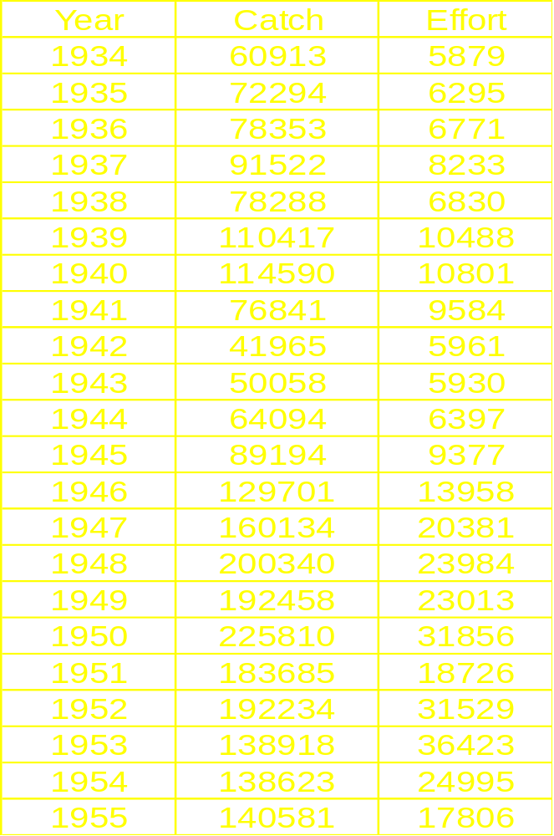

Slide 44
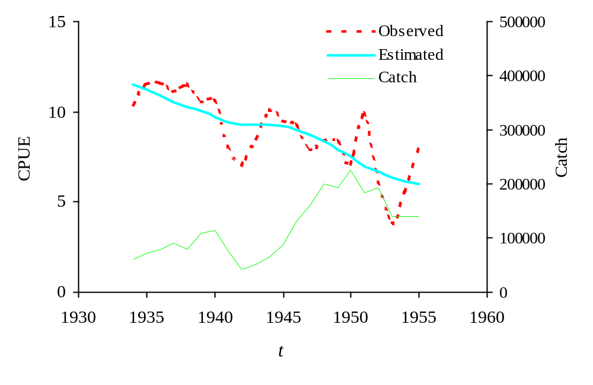
Time-Series Plot of Catch and Observed and Estimated CPUE

Slide 45
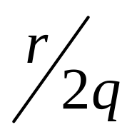
Estimated Stock Biomass Fishery Parameters:
r = 0.0798
K = 3,698,675
q = 0.0000027
B_{MSY} = = 1,849,338
MSY = = 73,768
f_{MSY} = = 14,658

Slide 46
Example Conclusions
The Schaefer equilibrium surplus production model estimated MSY at 190,000, and f_{MSY} at 32,000 exceeding our result by 150%, therefore the biomass dynamic model is substantially more conservative.
Other more complex biomass dynamic models differ from the results of our model by as much as 30%.

Slide 47
Summary and Conclusions
Biomass dynamic models are an improvement over equilibrium surplus production models.
Using the discrete time equation, surplus production is used to provide both stock expansion and catch, if surplus production exceeds catch. Conversely, if catch exceeds surplus production, then stock biomass contracts.

Slide 48
Summary and Conclusions
Biomass dynamic models require both catch data and a relative index of abundance.
Selection of initial parameter values is an art based on science and experience
If there is not sufficient “contrast” in the input data, then there may be multiple “best fit” solutions to the model, making interpretation problematic.

